Slide 1
Faculty of Applied Mathematics and Computer Science
Prepared by Pavel Zhukovskiy (Group №13)

Slide 2
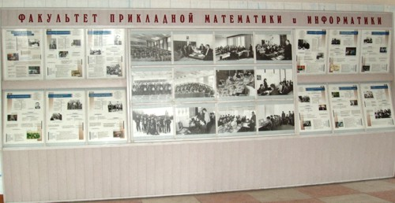
History of the faculty
Was founded in 1970 on April 1 as the Faculty of Applied Mathematics
Was renamed as the Faculty of Applied Mathematics and Computer Science in 1991

Slide 3
Departments of mathematics at the BSU till 1970
Department of Computational Mathematics
Department of Applied Mathematics
Department of Differential Equations
The Faculty of Applied Mathematics
The Faculty of Applied Mathematics and Computer Science

Slide 4
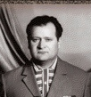
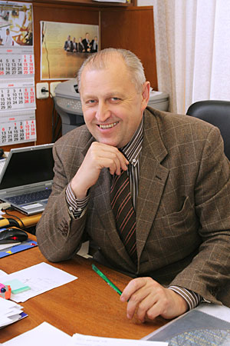
Professor E.A. Ivanov
Docent
P.A. Mandrik
The first dean of the Faculty (till 1981)
(from 1996 till now)

Slide 5
The faculty today
12 departments
9 research laboratories
7 educational laboratories
In-service training of specialists
Refreshment courses
Pre-university training

Slide 6
The faculty staff
More than 22 Professors
More than 90 Associate Professors
About ~1200 students
More than 200 students each year

Slide 7
specialties and qualifications
Faculty of Applied Mathematics and Computer Science
Applied Computer Science “Informaticien, Expert of Software Design”
Applied Mathematics “Mathematician-Programmer”
Computer Security
“Mathematician, Information Security Expert”
Economical Cybernetics / “Mathematician-Economist”
Actuarial Mathematics “Mathematician-Financier”
Computer Science “Mathematician-System Programmer”

Slide 8
the main disciplines
Computational Methods of Algebra
Theory of Probabilities and Mathematical Statistics
Functional Analysis and Integral Equations
Methods of Numerical Analysis
Methods of Optimization
Operations Research
Equations of Mathematical Physics
Numarical Methods of Mathematical Physics

Slide 9
the main disciplines (continuation)
Theoretical Mechanics
Algorithms and Data Structure
Data Models and DBMS
Computer Networks
Simulation and Statistical Modeling
Computer Service of Computing Experiment
Mathematical Modeling of Systems, Processes and Phenomena
Basis of Intellectual Property Management

Slide 10
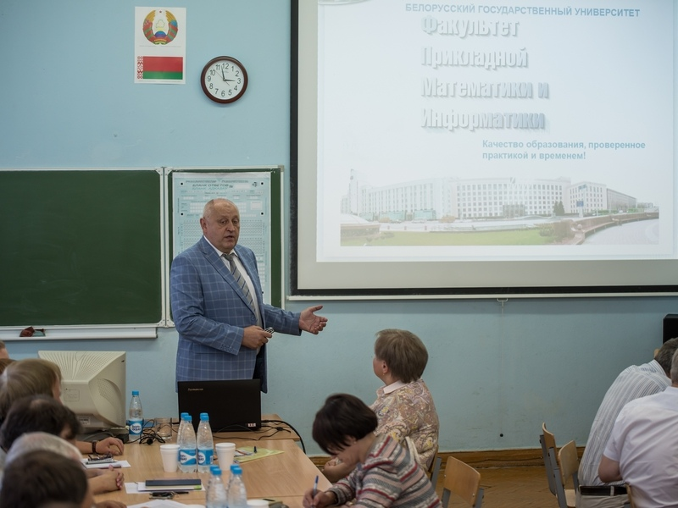
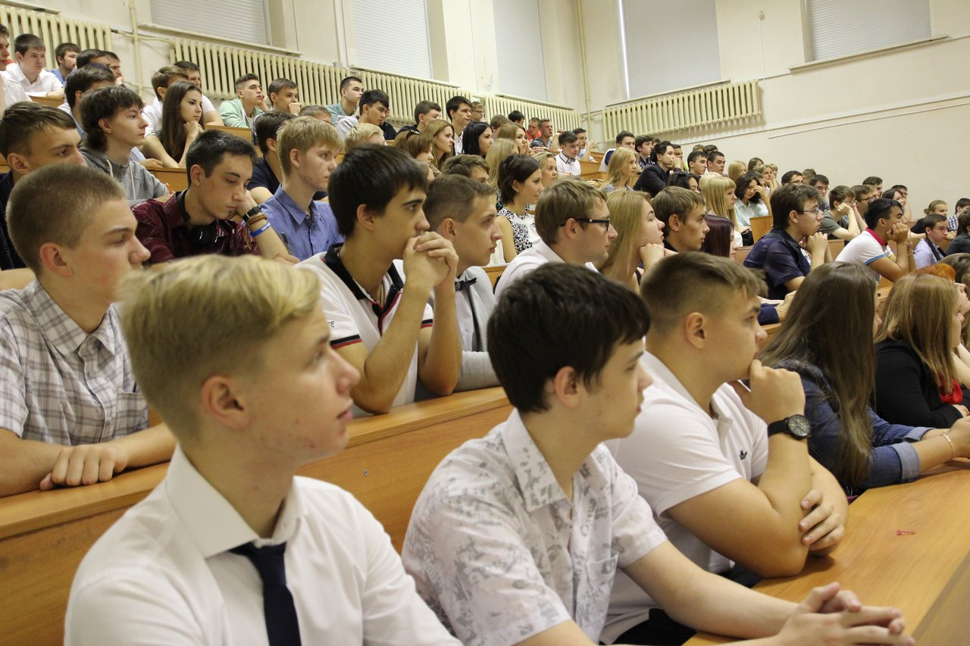
Competitions and Olympiads

Slide 11


International relationships
International organizations in Europe
International organizations in USA
Faculty of Applied Mathematics and Computer Science
International organizations in Asia

Slide 12
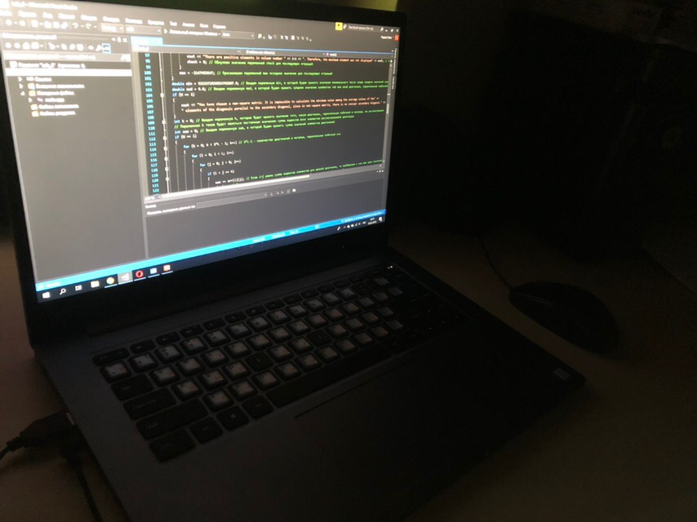
Why am I here?

Slide 13
Thanks for attention and good luck!

